Slide 1
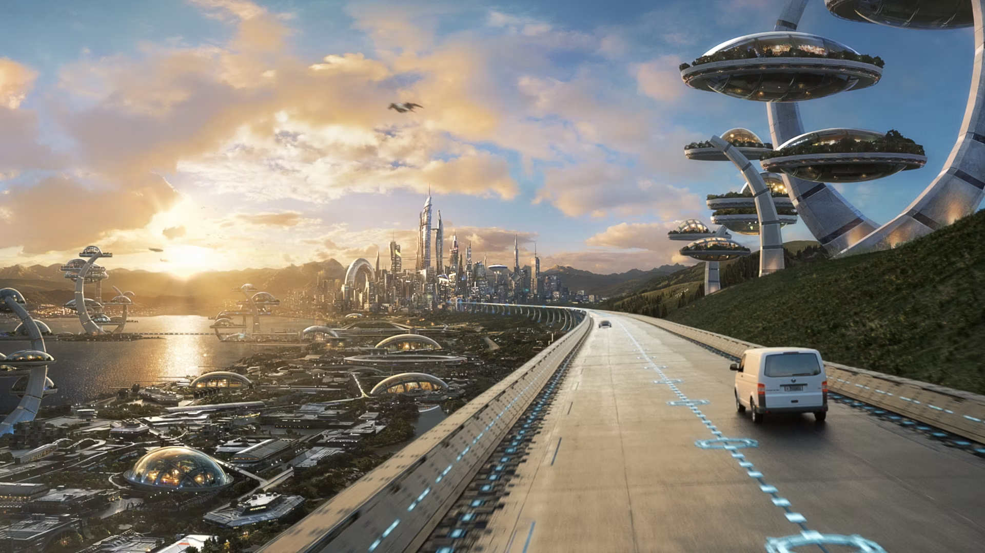
The Future of Cars and Mobility in Smart Cities
Smart cities promise a transformative future, driven by technology that revolutionizes urban living.

Slide 2
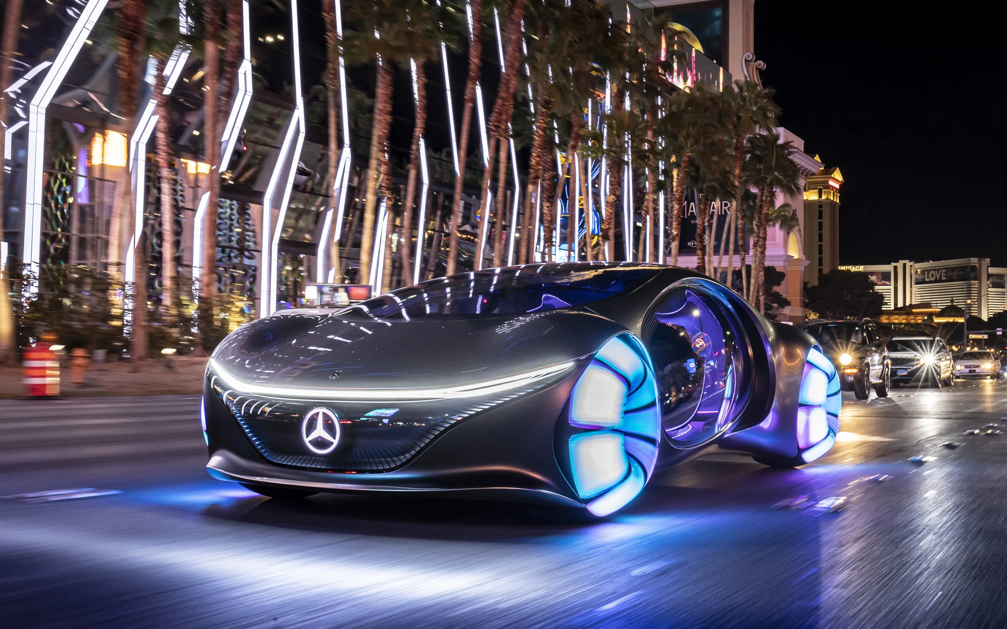
Autonomous Vehicles: Shaping Efficient Transportation
Autonomous vehicles eliminate human error, reducing traffic congestion and accidents.

Slide 3
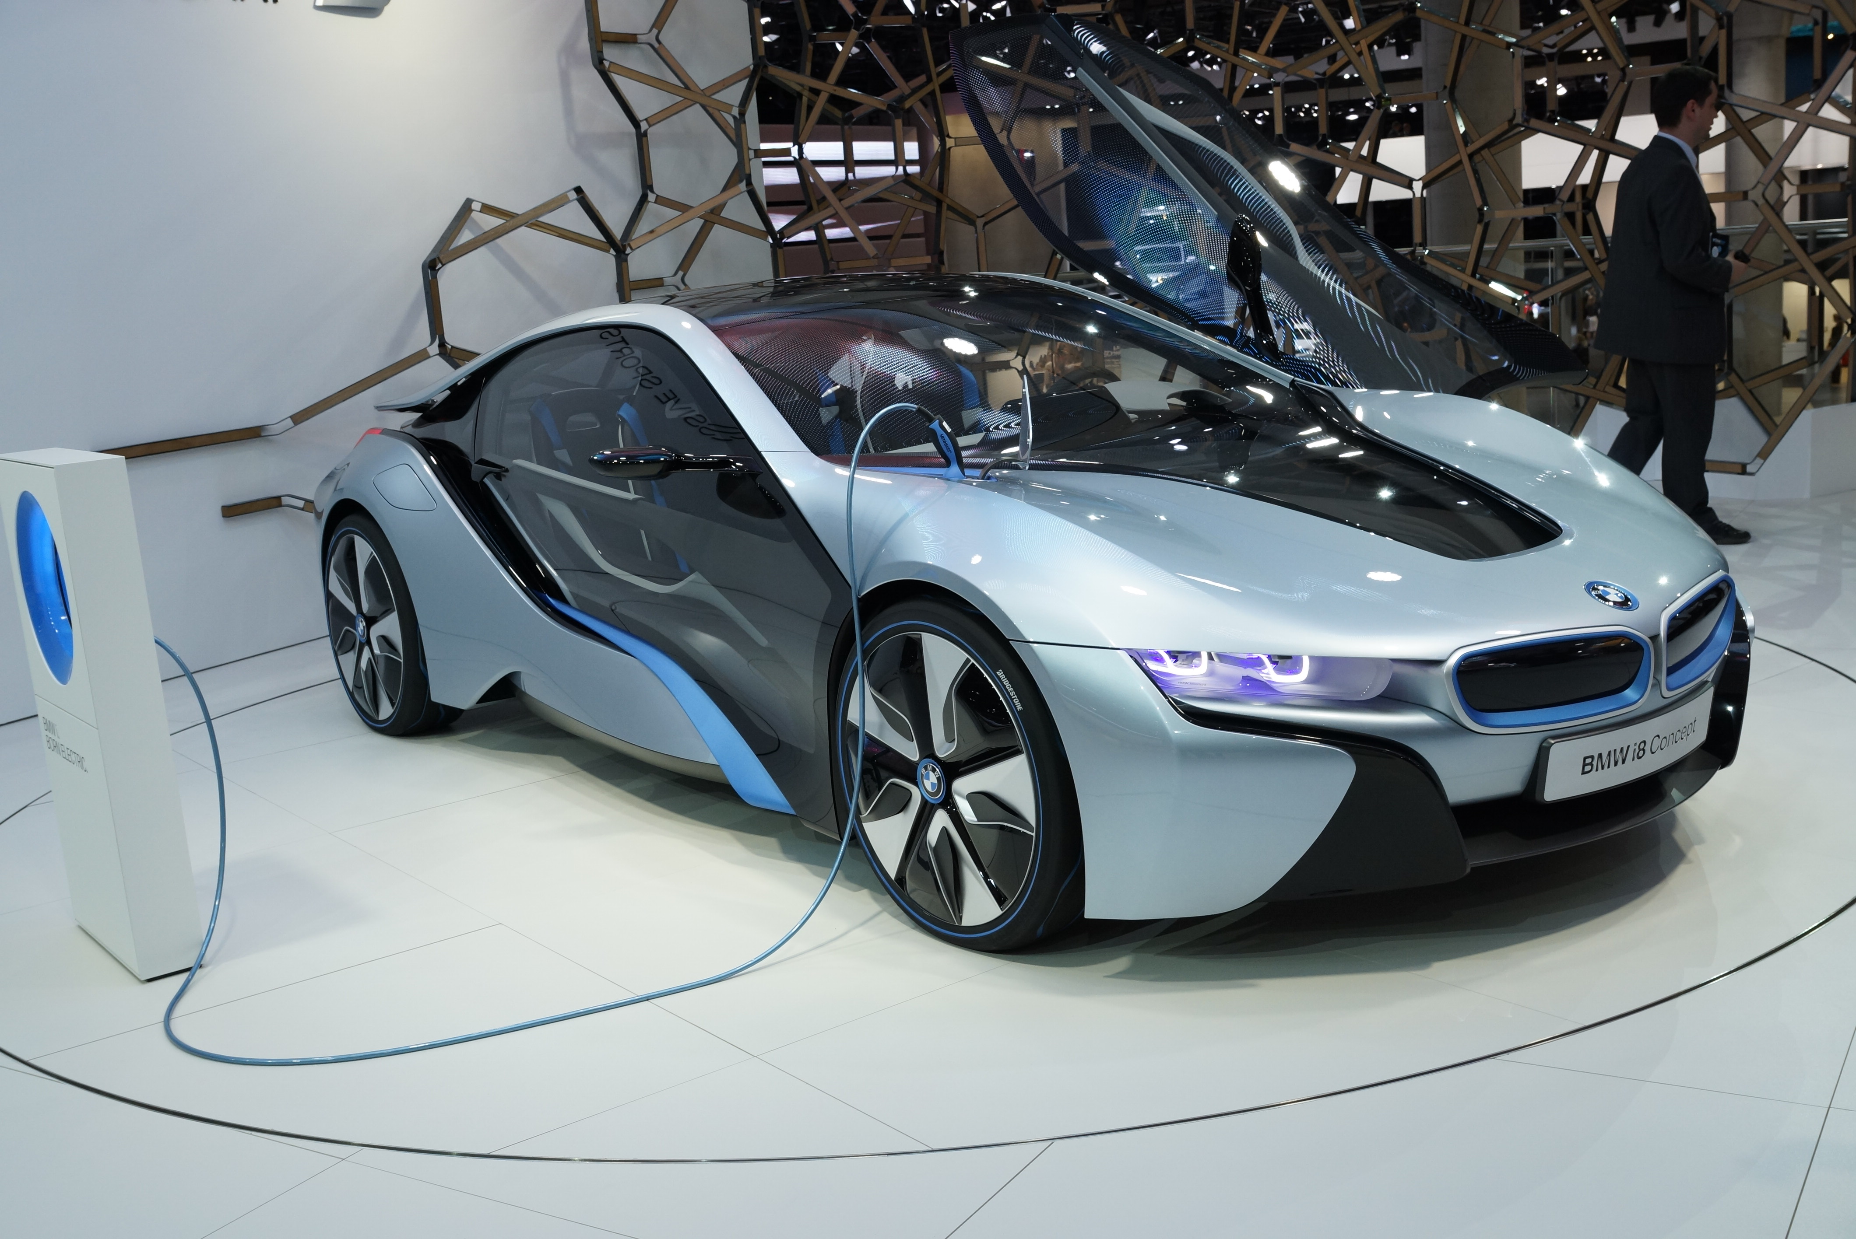
Electric Vehicles: A Sustainable Choice
Advancements in battery technology make EVs more affordable and practical.
Zero emissions at the tailpipe improve air quality and public health.

Slide 4
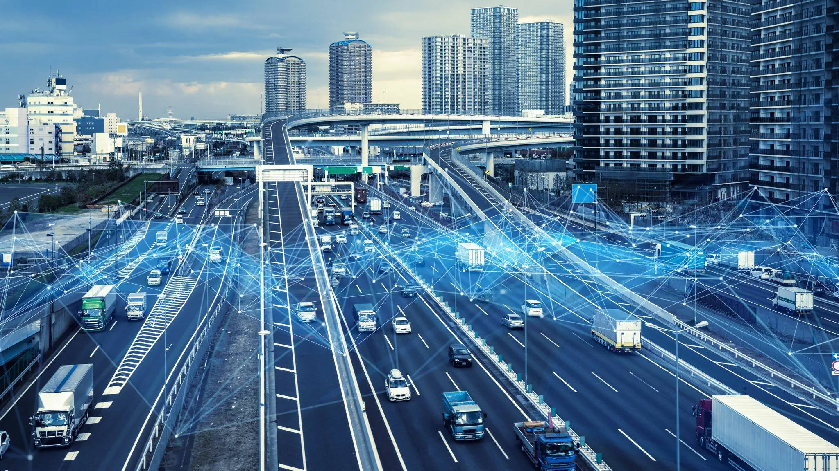
Building Smart Cities with Intelligent Transportation Infrastructure
Development of sensor networks and data analytics for traffic monitoring and congestion management.
Prioritizing pedestrian-friendly streets, cycling lanes, and efficient public transportation systems.

Slide 5
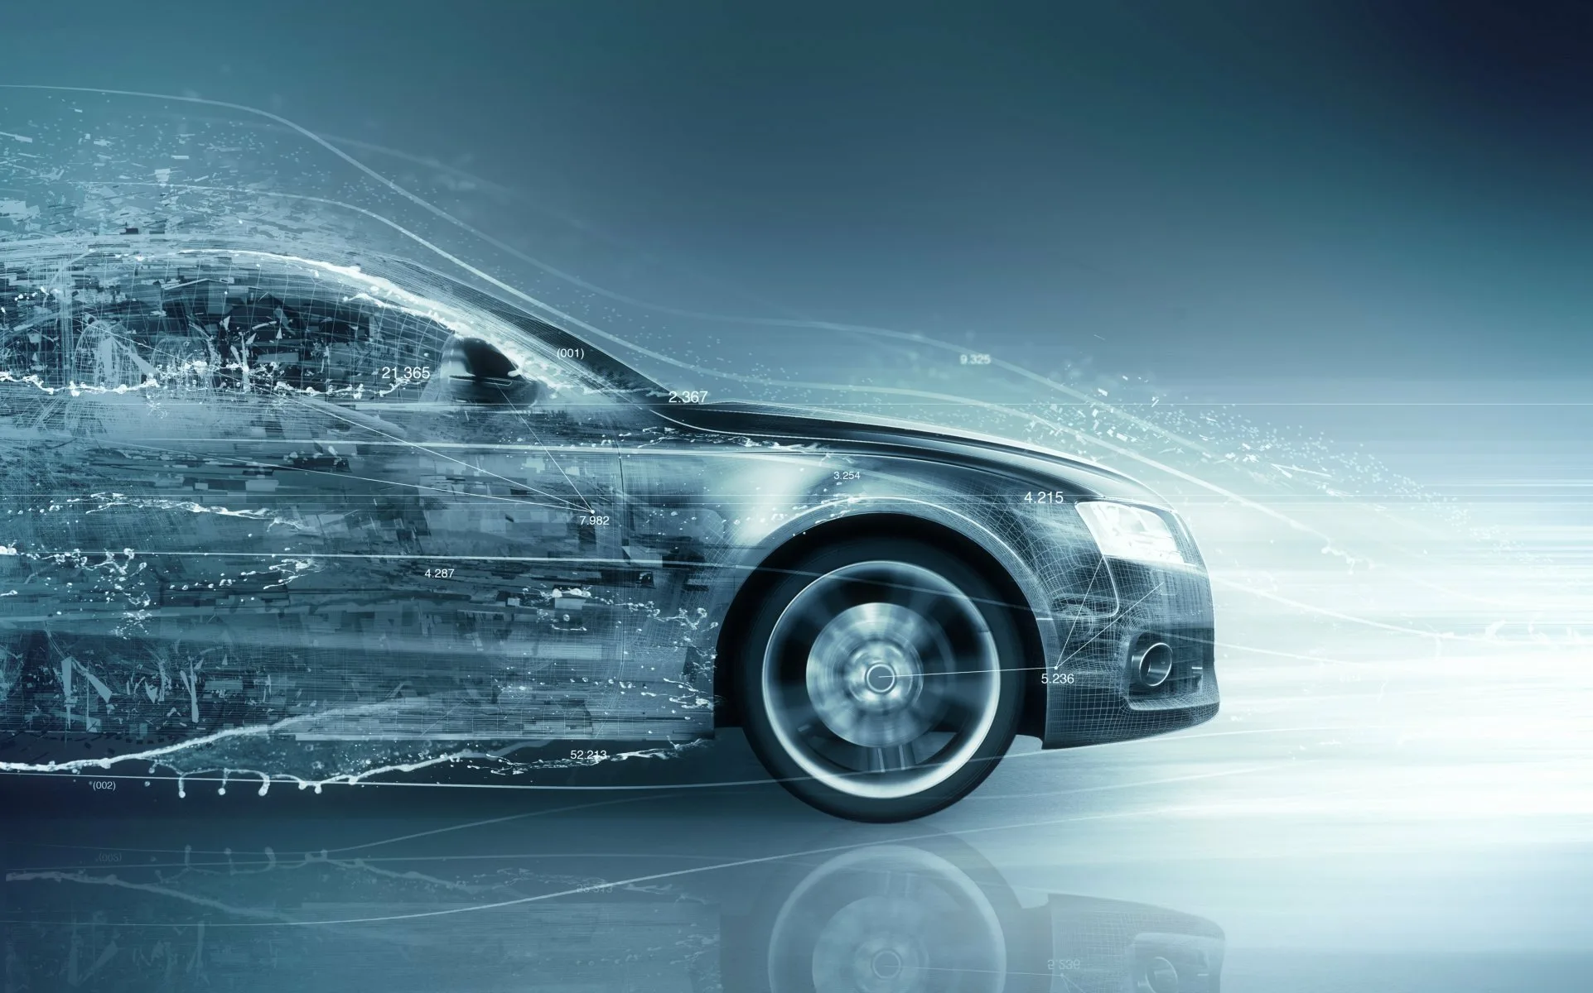
Integration of Technology and Sustainability

Slide 6

Thank You For Your Attention

